Slide 1
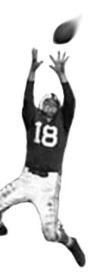
C105 PREDICTION, PROBABILITY & PIGSKIN
day 5: basics of empiricism
© Ben Motz, 2014

Slide 2
staying sharp? know these guys?
Owned by {percent} of leagues:
Allen Hurns (WR JAX) 0.8%
Dwayne Allen (TE IND) 5.9%
Isaiah Crowell (RB CLE) 0.2%
Justin Forsett (RB BAL) 0.3%
→ 23.0
→ 12.4
→ 15.2
→ 14.4

Slide 3
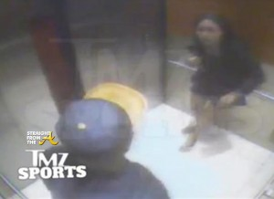
ray rice

Slide 5
C105 PREDICTION, PROBABILITY & PIGSKIN
day 5: basics of
empiricism
© Ben Motz, 2014

Slide 6
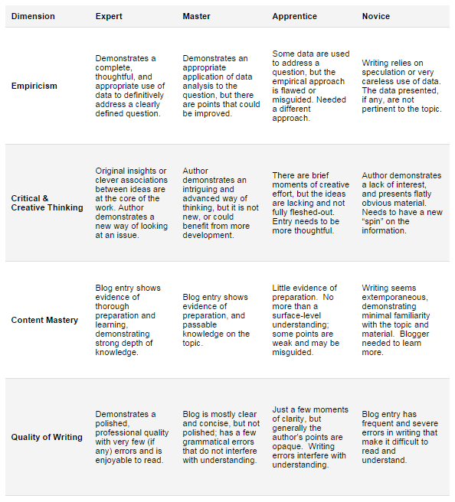

Slide 7
Apprentice: Some data are used to address a question, but the empirical approach is flawed or misguided. Needed a different approach.

Slide 9
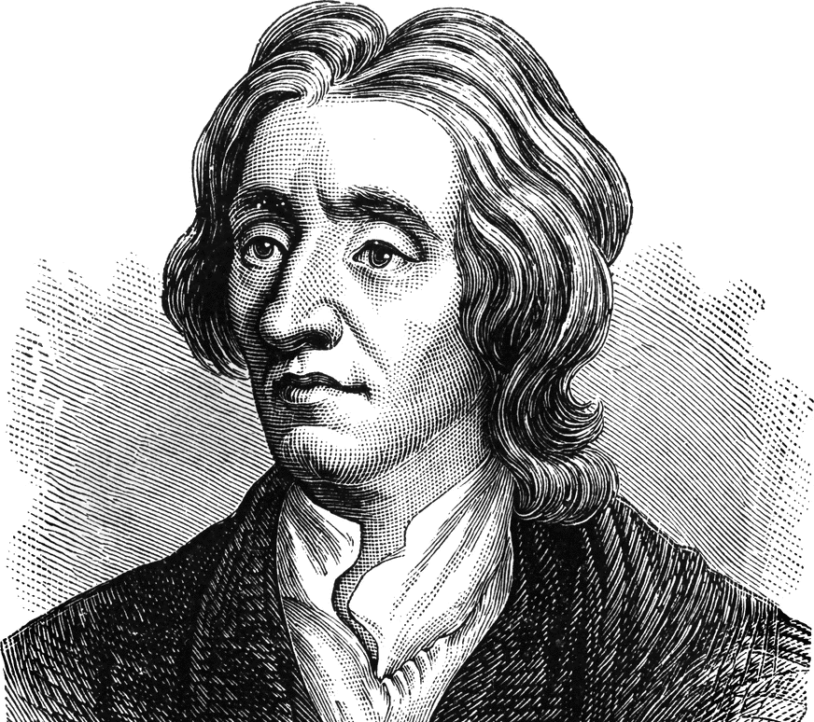
empiricism
john locke
⇒ ideas are not self-evident or innate
an idea
a hypothesis
…is something that must be testable by observation.

Slide 10
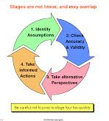
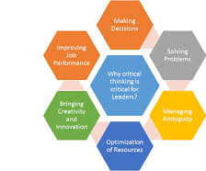
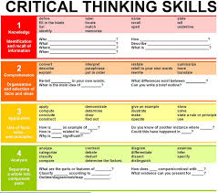
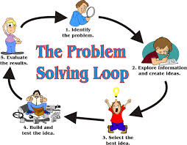
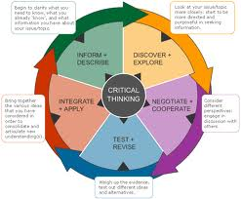
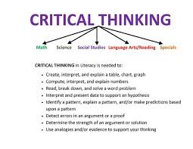
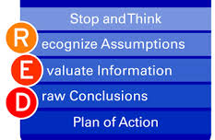
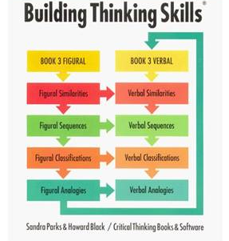
thinking empirically
be observant
recognize the need for data
consider variation
synthesis
skepticism

Slide 11
feature 1: be observant
what happened in the past week?
-- in football games
-- on your team
follow @ESPNStatsInfo (if you dare)
what are sports writers saying?
ask: why?
how?
when?

Slide 12
an aside on being observant…
as a species, we’re really pretty unobservant
“how does a toilet work?”
Notes:
Change blindness

Slide 13
feature 2: seek data (interrogate)
what would useful evidence look like?
are the data in the pigskin database?
no
yes
woot!
start translating the data into evidence

Slide 14
data = a means, not an end
5.5 points against CAR
translating the data into evidence
littering your writing with numbers is not being empirical
WEEK 2, 2013: “Start him: Marshawn Lynch, Seahawks: Yes, I have to include him because of everyone that was freaking out about his poor performance in week 1. You drafted him first round (most of you drafted him top three), so don't let one game dictate your outlook on him. He is playing against the 49'ers defense which he scored 25 fantasy points on last year. Over his last 17 games he has averaged 19.5 rushing attempts a game, with an average of 96 yards per game. With so many split backfields this year, its hard to compete with this kind of consistency.”

Slide 15


feature 3: consider variation
claim: marshawn lynch will earn lots of fantasy points against the 49ers in week 2 (2013), even though he flopped in week 1.
does the fact that lynch scored 25 fantasy points on SF in 2012 provide strong support for this claim?
does lynch’s 19.5 average points in 2012?
Notes:
Level up, and zoom out.

Slide 16
don’t just consider variation love variation

Slide 17

feature 4: synthesis
A set of data, on its own, is an arid, context-free landscape.
What is happening?
context
data
What does this mean?
Notes:
Level up, and zoom out.

Slide 18
feature 5: skepticism
“what we ‘know’ is not only our greatest asset but also our biggest curse because the foundations of what we ‘know’ are often not soundly based.”
ask yourself: is this a fluke?
is this right?
does this address the question?
am i being guided by my own unwarranted preconceptions?

Slide 19
IS TRENT A FANTASY SCARE?
Trent Richardson, 3rd Overall Pick by the Cleveland Browns in the 2012 NFL Draft, has Fantasy owners unsure. Just shy of 1000 yards in his rookie season Trent was looking like he was going to breakout in 2013 but it was the complete opposite. Richardson started the season off on the Browns only playing the first 2 weeks and then he got traded to the Colts. In the 16 games he played during the 2013 season he only put up half of what he had the previous year. This season Fantasy Owners are a little hesitant putting him in there starting lineup. I know I would be. With Ahmad Bradshaw joining the team I see Trent’s fantasy value go way down. Also to keep in mind if Trent does struggle, Ahmad could take Richardson’s starting spot. Another thing to think about is being a running back for a team like the Colts who primarily throw the ball more than not. The Colts Offensive Line is weak and its tough to imagine Richardson having a breakout year considering the Colts will rely on Andrew Luck mostly. With all eyes on Trent going into the preseason we just saw more of the same. Averaging only 2.9 yards per carry. He going to have to get a lot better until fantasy owners can start to trust him again.

